Slide 1
Microsoft Project 2010 – Introduction, Part 2
Phil Pfeiffer
Fall, 2014

Slide 2
This Presentation's Structure
Part 1
Common features & their uses
Gantt Chart View
Tasks
Scheduling Modes: Manual Mode
Inter-Task Dependencies
Resources
Other operations on tasks
Part 2
Common features, uses (cont.)
Overallocation
Duration, Units, Work
Scheduling Modes: Auto Scheduling
Scheduling Modes: Recommendations
Part 3
Common features, uses (cont.)
Summary tasks and subtasks
Summary Tasks: Auto Scheduling
Summary Tasks: Inter-Task Dependencies
Calendars
Calendar Management
Part 4
Common features, uses (cont.)
Calendar Management (cont.)
Modifying Calendars
Skewed Calendars
Calendar Architectures
Project Tracking
Key limitations and gotchas

Slide 3
Overallocation
Too much work to be done with too few resources, typically in too little time
Flagged by Project
Resolved by project managers

Slide 4
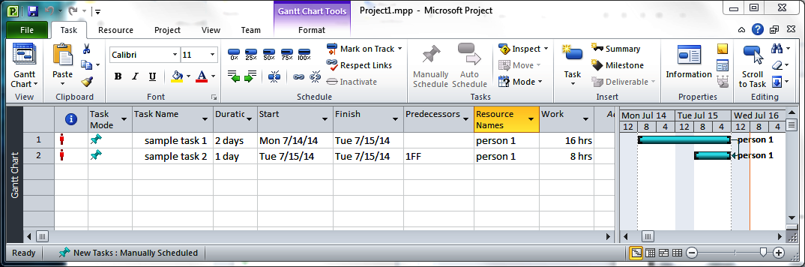
Overallocation: Gantt Chart View
This example shows an overallocation resulting from allocating all available units of a common resource to two overlapping tasks.
Project's Gantt Chart view shows a bold red stick figure in the affected tasks' information fields.
Hovering the mouse over the stick figure yields a pop-up box that says "This task has resources assigned which are overallocated. Right-click for options."

Slide 5
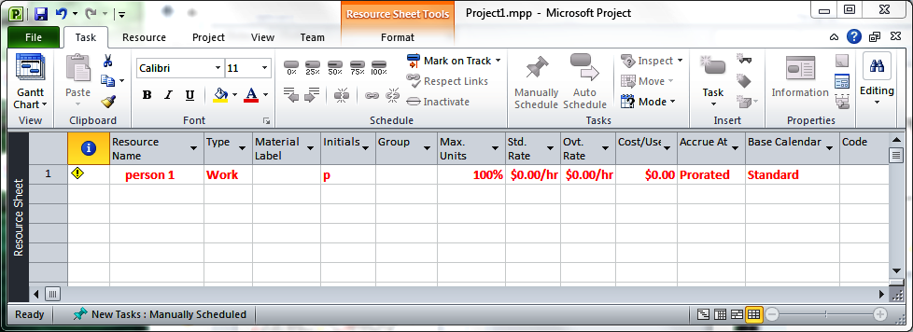
Overallocation: Resource Sheet View
This view shows overallocated resources in bold red.
Hovering over the warning icon ( ) in the information field produces a pop-up box that says "The resource is overallocated and should be leveled."

Slide 6
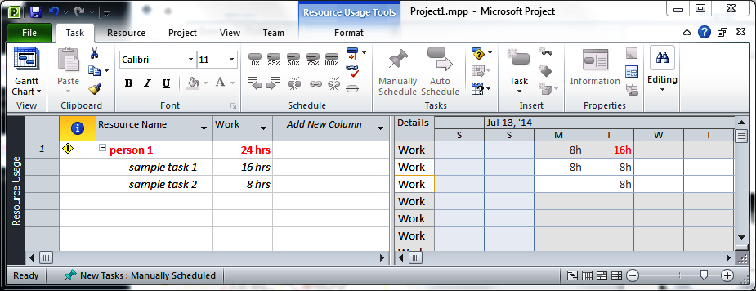
Overallocation: Resource Usage View
The Resource Usage View, like the Resource Sheet View, highlights the names of overallocated resources in bold red and shows the warning ( ) icon in the information field.
It also shows the total hours in the right-hand side of the windows, highlighting the overallocated time frame in red.

Slide 7
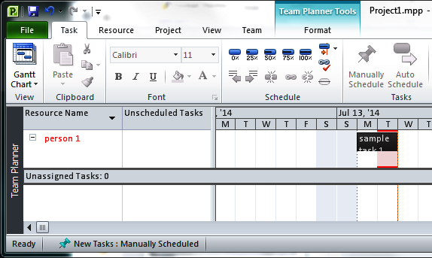
Overallocation: Team Planner View
This view highlights the names of overallocated resources in bold red and adds thin red stripes to the top and bottom of rectangles for overallocated tasks

Slide 8
Managing Overallocation
Overallocation can be ignored: i.e., by requiring overtime.
Overallocation can be "eliminated" by extending the work week.
Project defaults to M-F, 8-12 am/1-5 pm work week
Calendar management will be addressed later in the semester
As a rule, forced overtime should be avoided.
Overallocation can be eliminated by reducing % of employee effort
Works if full-time effort (default in Project) isn't really required
Overallocation can be eliminated by increasing resource allocation
Strategy known as crashing a schedule
Works if task is effort-centric; fails (e.g.) for time lost to meetings
Overallocation can be eliminated by increasing the schedule, on
a per-task basis, or
across the project as a whole
Works in absence of deadlines, or if deadlines are soft
Different strategies work better for different situations

Slide 9
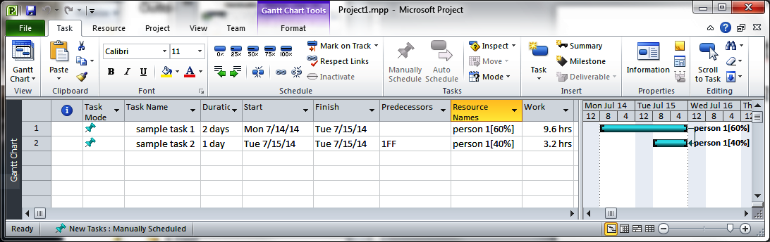
Overallocation Mgmt.: Partial Allocations
Non-default resource allocations—i.e., allocations of other than 100%--can be specified by enclosing them in square brackets following the reference to the resource in the resource names field.
Here, assigning person 1 60% time on task 1 and 40% time on task 2 eliminates the overallocation.

Slide 10
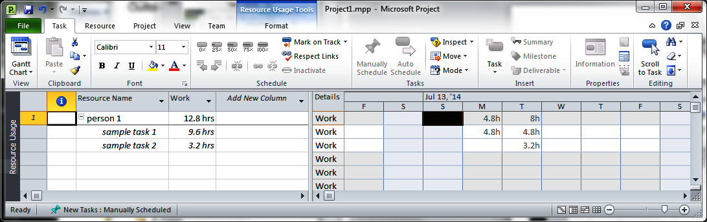
Overallocation Mgmt.: Partial Allocations
The allocation strategy shown on the previous slide -- 60% time on task 1 and 40% time on task 2 -- also reduces the amount of time that person 1 works on sample task 1 on 7/14/14 to 4.8 hours.
Unfortunately, I know of no way of allocating
100% of person 1's time to task 1 on Monday and
60% of person 1's time to task 1 on Tuesday,
short of splitting task 1 into two subtasks.

Slide 11
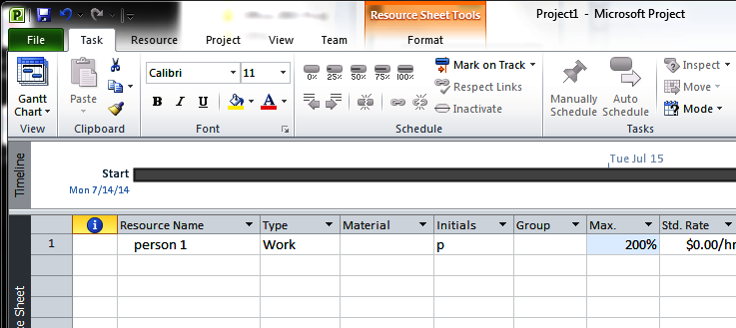
Overallocation Mgmt.: Adding Resources, Take 1
Increasing one resource's max percentage to 200% is equivalent to allocating two comparable resources to a project.
Often simpler than explicitly naming a second person when differentiation between individuals not a concern.

Slide 12
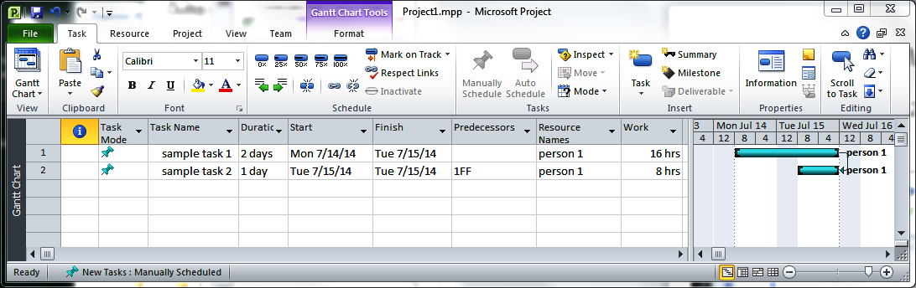
Overallocation Mgmt.: Adding Resources, Take 1
Updated Gantt Chart with person 1 allocated at 200% lacks warnings in information field and preserves the original 24 hours' worth of work.
The new schedule does, however, require more resources.

Slide 13
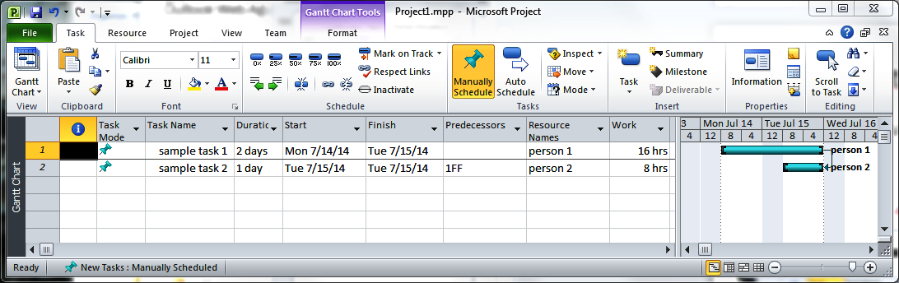
Overallocation Mgmt.: Adding Resources, Take 2
Explicitly adding a second person also resolves the overallocation

Slide 14
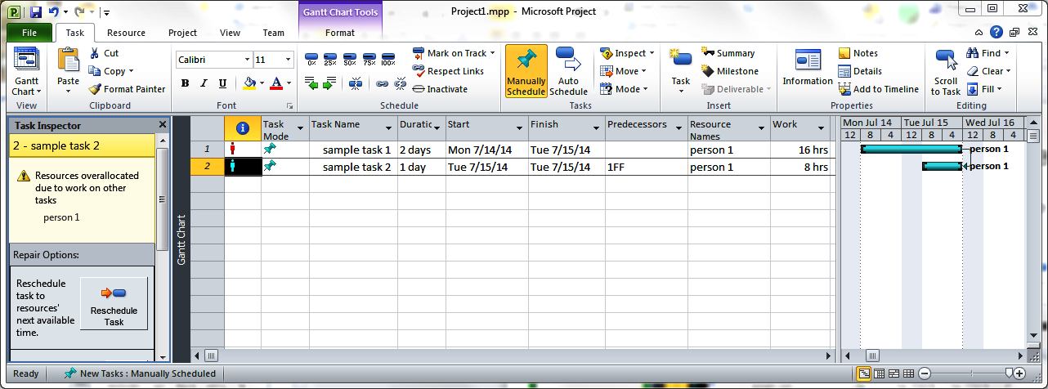
Overallocation Mgmt.: Stepwise Levelling, Take 1
Right-clicking on task 2's warning field yields two options:
Reschedule task to resources' next available time
Fix task in Task Inspector
Task Inspector offers rescheduling task 2 as sole option

Slide 15
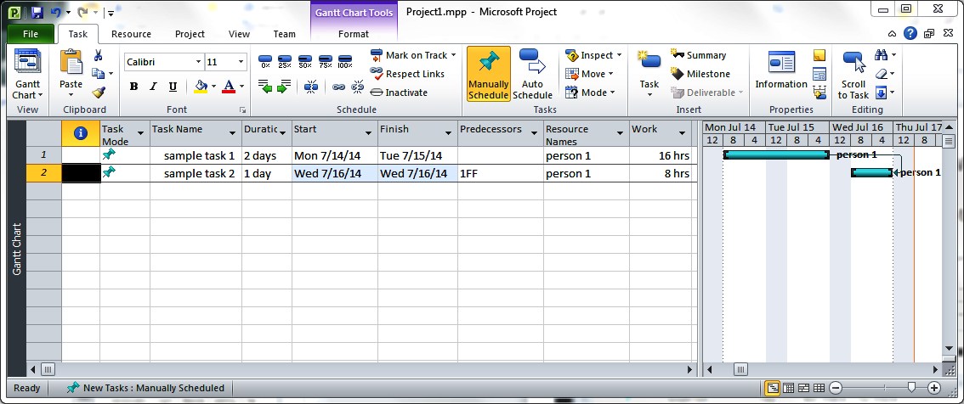
Overallocation Mgmt.: Stepwise Levelling, Take 1
Rescheduling task 2 does indeed fix the problem.
Project moves task 2 to next available date
Action eliminates overallocation while preserving the FF.

Slide 16
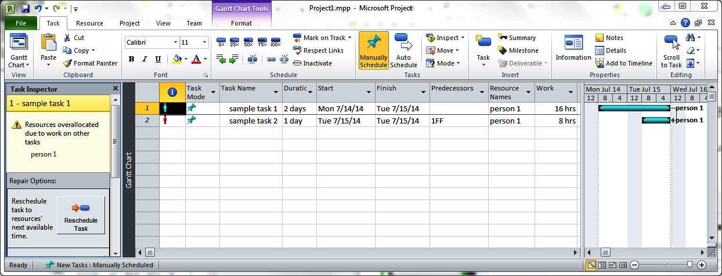
Overallocation Mgmt.: Stepwise Levelling, Take 2
Trying to work through the overallocation by focusing on task 1, for this schedule, is less successful.
Once again, Task Inspector offers rescheduling as sole option

Slide 17
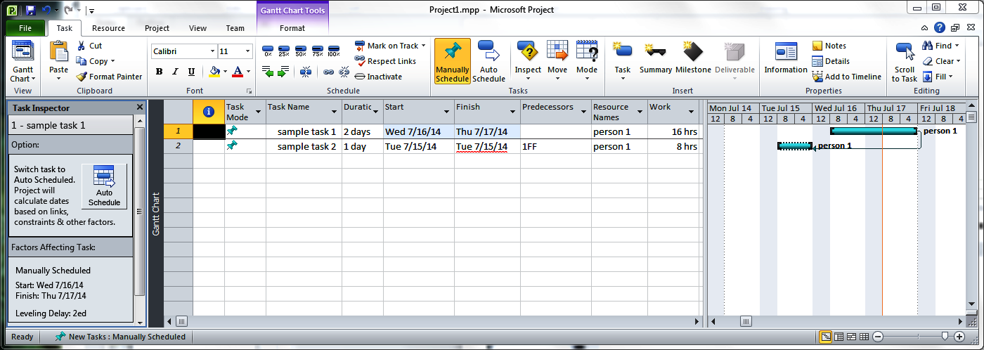
Overallocation Mgmt.: Stepwise Levelling, Take 2
Rescheduling task 1, however, breaks the FF dependency.
Task inspector throws up its hands, suggests switch to auto scheduling
Closer inspection of Gantt chart shows that task 2's task bar turned squirrelly

Slide 18
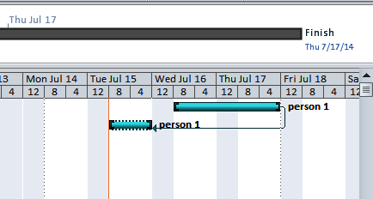
Overallocation Mgmt.: Stepwise Levelling, Take 2
Gantt Chart View - 2 linked tasks, per-task resource leveling
A closer look at the Gantt Chart after the initial rescheduling of task 1

Slide 19
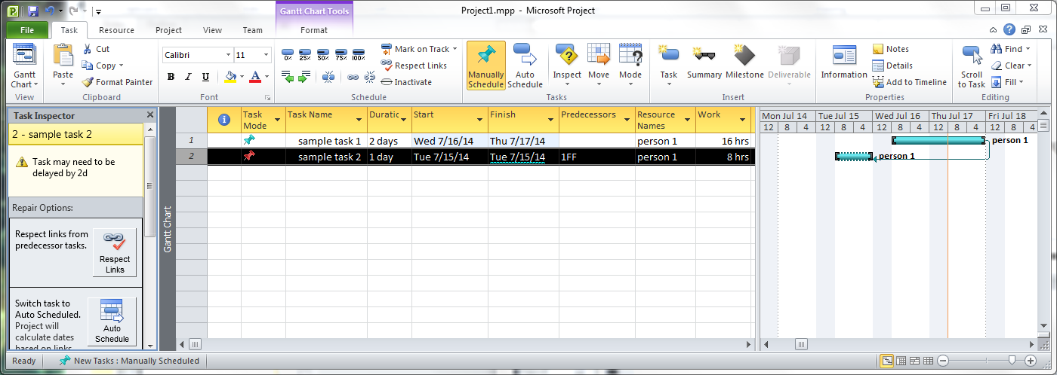
Overallocation Mgmt.: Stepwise Levelling, Take 2
Gantt Chart View - 2 linked tasks, per-task resource leveling
Clicking task 2's task bar yields a clearer analysis from Task Inspector
The warning correctly identifies a broken FF dependency as problem
Inspector now suggests either fixing dependency by either
delaying task 2 by 2 days or
switching to auto scheduling

Slide 20
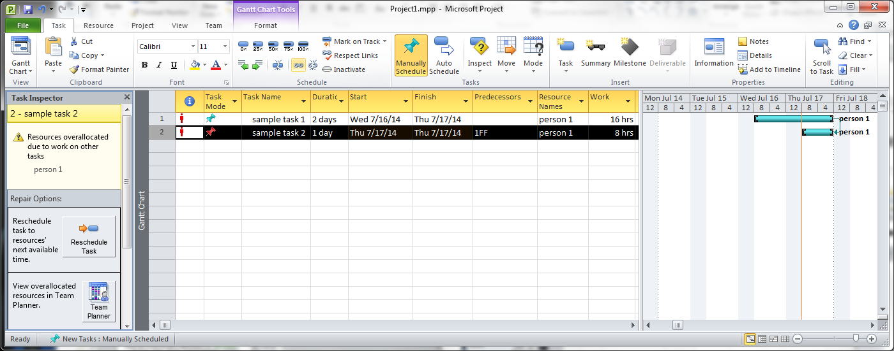
Overallocation Mgmt.: Stepwise Levelling, Take 2
Following Task inspector's advice, however, simply recreates the original overallocation problem, starting on 7/16 rather than 7/14.
This is an example of an issue that I've occasionally run into in Project:
Project is sometimes smart enough to detect a scheduling problem
but not quite smart enough to fix it.

Slide 21
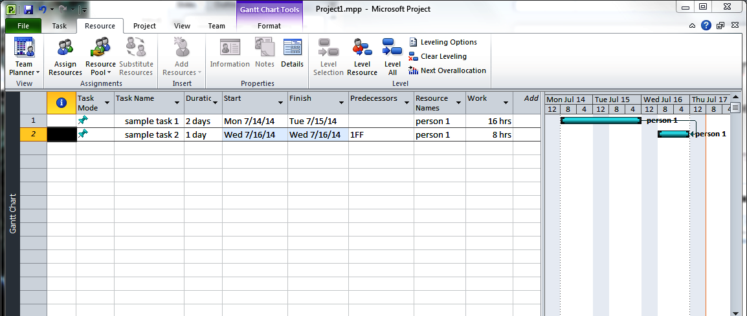
Overallocation Mgmt.: Auto Levelling, Take 1
Project's "level all" option also corrects the overallocation.
Accessed via Level All icon on Resource tab
Most comprehensive, potentially most time consuming, of options
Reasonably fast, for smaller (<100?-task) project files

Slide 22
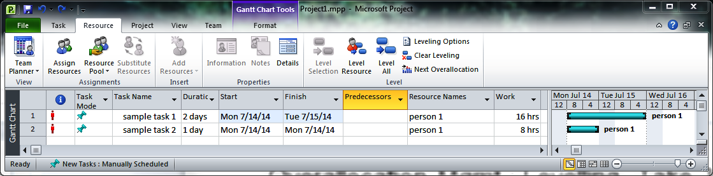
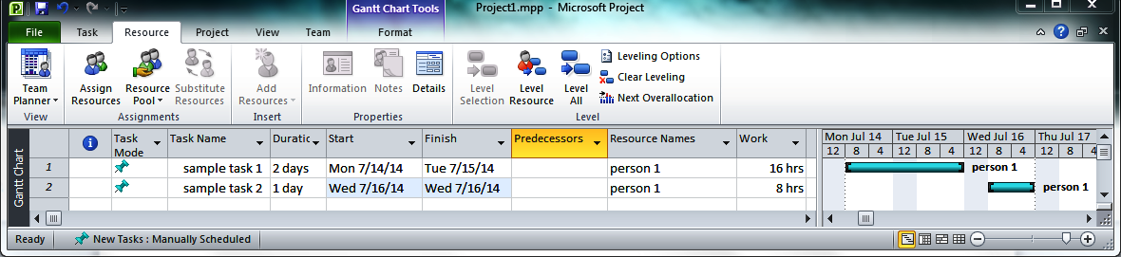
Overallocation Mgmt.: Auto Levelling, Take 2
Before leveling
After leveling
In the absence of dependencies, Project's leveling algorithm prioritizes tasks with lower line numbers over tasks with higher line numbers

Slide 23
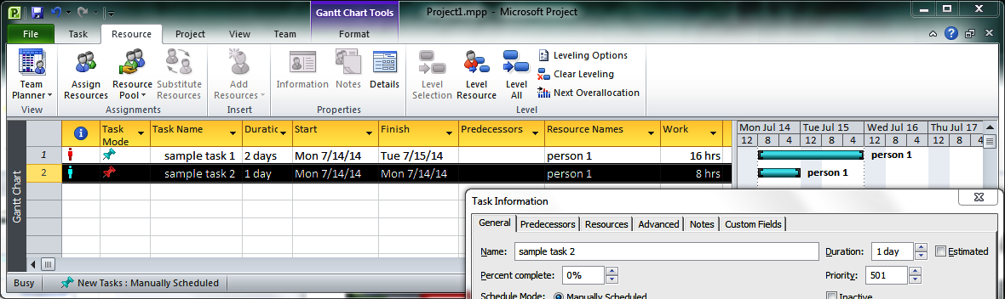
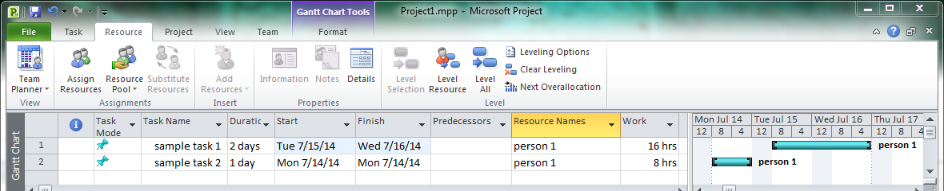
Overallocation Mgmt.: Auto Levelling, Take 2
Before leveling
After leveling
Leveling behavior can be influenced by adjusting task priorities.
Project associates every task with a priority from 0 (lowest) to 1000 (highest)
By default, all tasks have a priority of 500
Here, raising task 2's priority causes leveling to schedule it before task 1.

Slide 24
Duration, Units, Work (D/ U/ W)
Project 2010 scheduling formula: duration x units = work
Duration
time to complete task, in "wall clock" time
shown in task view in "duration" field
Units
resources to allocate to task
shown in task view in "resources" column
Work
human time required to complete task
shown in "work" column, which must be added to default fields
In manual mode, Project 2010 ignores duration, focusing instead on varying units directly with work and vice-versa.

Slide 25
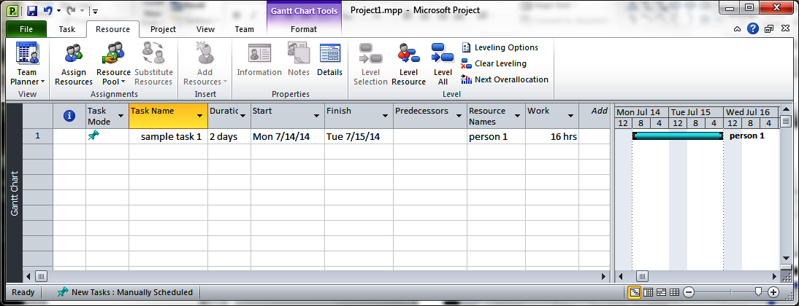
Duration, Units, Work in Manual Scheduling
Work for task 1 – 16 hrs – computed automatically by Project 2010 from duration and default project calendar: i.e.,
16 hours/ person 1 = 2 days * 8 hrs/person-day * 100% person-day/person 1

Slide 26
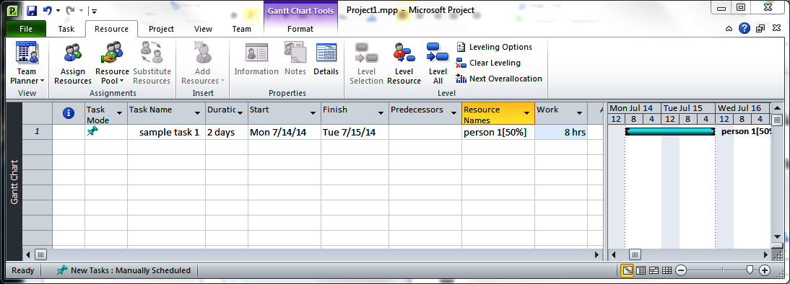
Duration, Units, Work in Manual Scheduling
Changing person 1's allocation to 50% changes work to 8 hours
In manual mode, manager would be responsible for doubling duration to preserve overall work – assuming work is invariant

Slide 27
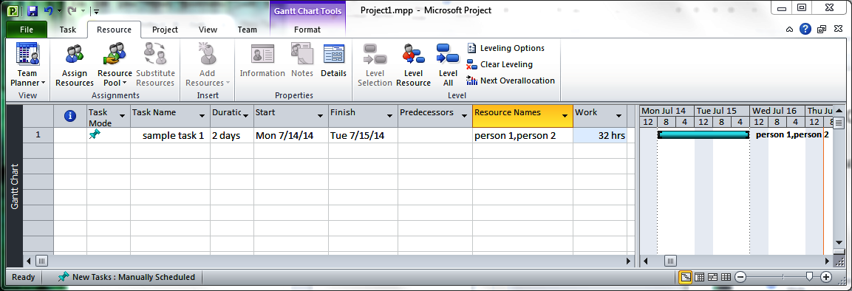
Duration, Units, Work in Manual Scheduling
Committing two people at 100% workload changes work to 32 hours
In manual mode, when time to complete is invariant, manager must halve duration by hand after doubling resources

Slide 28
Auto Scheduling
Auto scheduling is Project 2010's other scheduling mode.
Project 2010 allows users to specify whether tasks are to be manually scheduled or auto scheduled, on a task-by-task basis
When tasks are auto scheduled, Project 2010 manages all their scheduling parameters, including their durations.

Slide 29
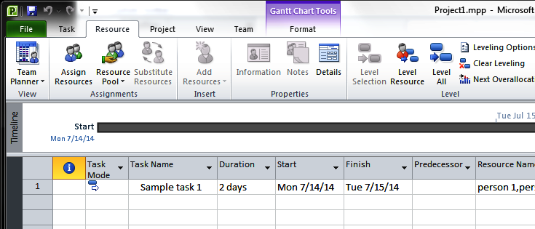
Auto Scheduling
Clicking in task 1's task mode field and selecting dropdown shows option for auto scheduling.
Icon changes from thumbtack/? to blue bar/right arrow, as shown above.

Slide 30
Auto Scheduling
The following table compares how Project's manual scheduling and auto scheduling algorithms manage task fields:
Field | Manual Scheduling | Automated Scheduling
Duration | Any content. Ignored for scheduling. For new tasks, initialized to blank. | Only valid durations allowed. For new tasks, initialized to 1 day?
Work | Only valid durations allowed. For new tasks, initialized to 0 hours. | Only valid durations allowed. For new tasks, initialized to 0 hours.
Resources | Any content. Ignored for scheduling. | Used by Project to help determine best schedule. Will change durations if tasks are set to effort-driven, unlike manually scheduled tasks.
Start date, Finish date | Any content. Ignored for scheduling. For new tasks, initialized to blank. | Only valid points in time allowed. For new tasks, initialized to project start date.
Constraints, project calendars, resource calendars | Ignored for scheduling. | Used by Project to help determine best schedule.
Source: http://office.microsoft.com/en-us/project-help/how-scheduling-works-in-project-HA010373148.aspx

Slide 31
Auto Scheduling Modes
Rationale
Changes to schedules are often constrained by a need to keep one dimension of a schedule constant while making this change: e.g.,
Absorb extra work relative to a set group of workers
Decrease duration relative to a set workload
Decrease personnel relative to a set workload
Project 2010's modal auto-scheduling mechanism addresses this common case, while allowing for opt-out for non-typical scenarios
Mechanism
Following a change to duration, units, and/or work, automatically adjusts the value of a second item to maintain the current value of a third
Adjustment determined by one of three user-selected scheduling modes:
fixed duration: preserve work/units following changes to work or units
fixed units: preserve work/duration following changes to work or duration
fixed work: preserve duration*units following changes to duration or units
Adjustment for changing # resources also affected by effort-driven property
Adjustment always accompanied by an information (ⓘ) pop-up, which offers other ways of rebalancing duration, units, and work

Slide 32
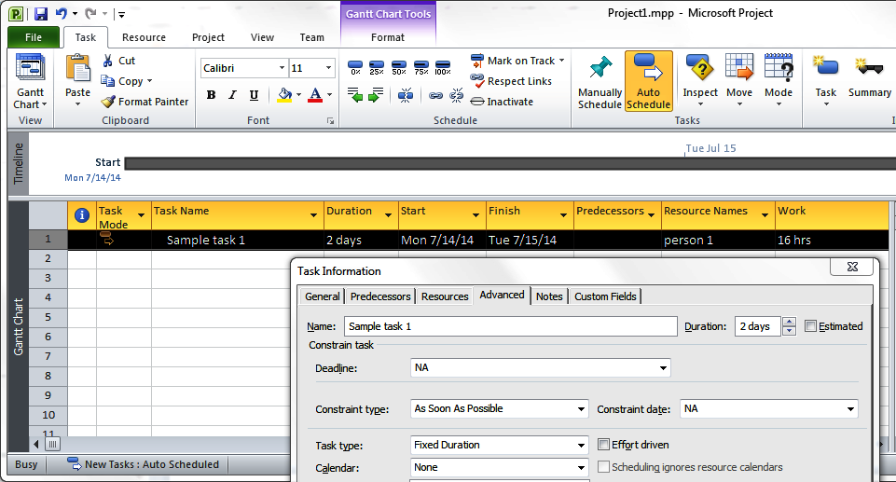
Auto Scheduling by Example: Fixed Duration
Task information menu's task type field shows task type as Fixed Duration
For initial examples, sense of effort-driven flag doesn't matter

Slide 33
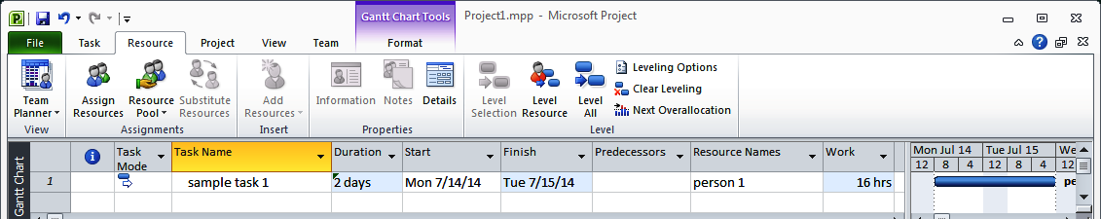
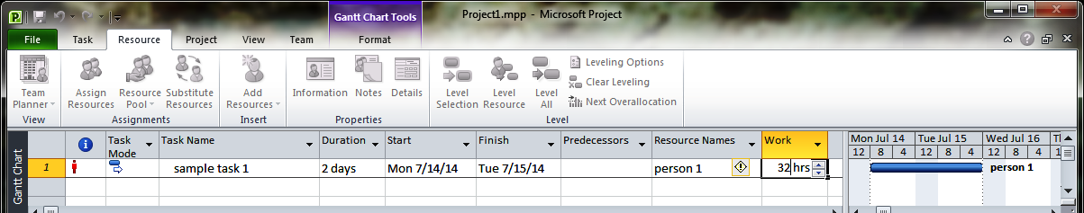
Fixed Duration Scheduling: Increased Work
Increasing work from 16 hours to 32 hours has the following effects:
preserves duration by increasing person 1's work day to 16 hours (confirmed with Resource Usage View; note overallocation warning)
raises an information box, which, when clicked, affords two options:
keep schedule shown above
keep original resource usage: double duration to 4 days instead

Slide 34
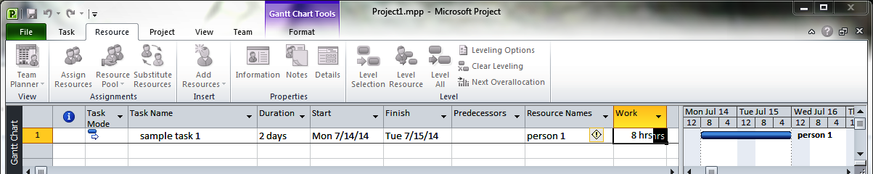
Fixed Duration Scheduling: Reduced Work
Reducing work from 16 hours to 8 hours does the following:
preserves duration by reducing person 1's work day to 4 hours (confirmed with Resource Usage View)
raises an information box, which, when clicked, affords two options:
keep schedule shown above
keep original resource usage: halve the duration instead

Slide 35
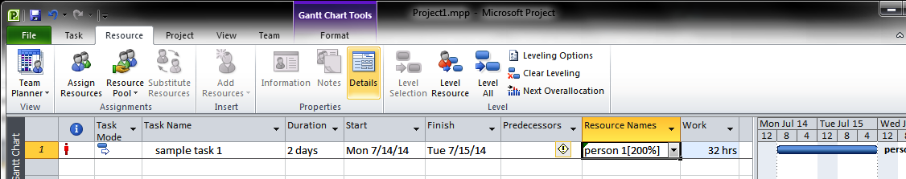
Fixed Duration Scheduling: Increased Units
Increasing person 1 to 200% time does the following:
preserves duration by increasing work to 32 hours
raises an information box, which, when clicked, affords two options:
keep schedule shown above
keep original work: halve duration to 1 day instead

Slide 36
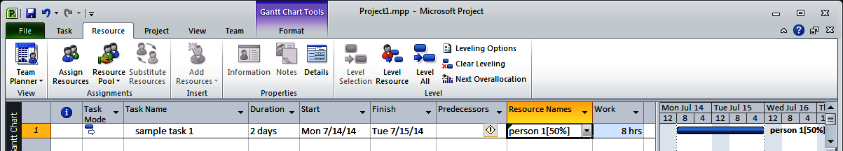
Fixed Duration Scheduling: Reduced Units
Cutting person 1 to 50% time does the following:
preserves duration by reducing work to 8 hours
raises an information box, which, when clicked, affords two options:
keep schedule shown above
keep original work: double duration to 4 days instead

Slide 37
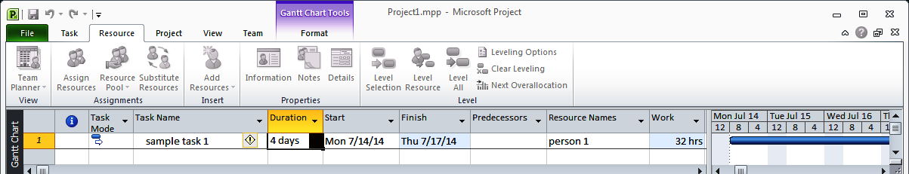
Fixed Duration Scheduling: Increased Duration
Doubling the initial task's duration does the following:
doubles work from 16 to 32 hours
raises an information box, which affords two options:
keep schedule shown above
keep original work; work person 1 200% time

Slide 38
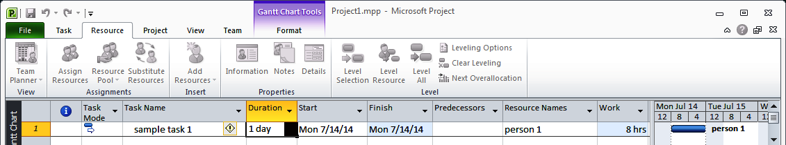
Fixed Duration Scheduling: Reduced Duration
Halving the initial task's duration does the following:
halves work from 16 to 8 hours
raises an information box, which affords two options:
keep schedule shown above
keep original work; work person 1 200% time

Slide 39
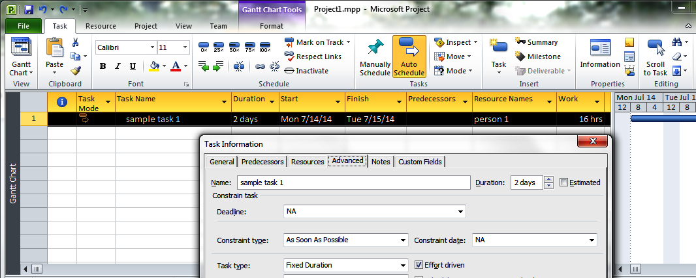
Fixed Duration Scheduling, Changing the Number of Resources
Two cases:
Effort-driven scheduling is enabled
Effort-driven scheduling is disabled

Slide 40
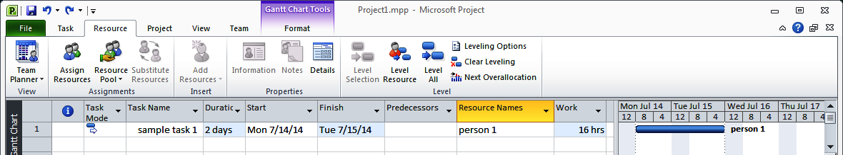
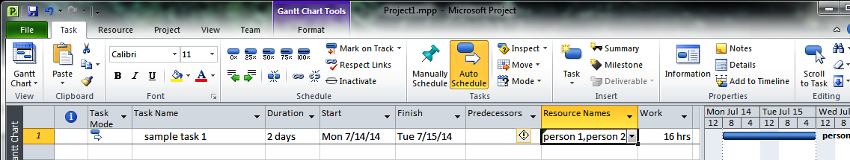
Fixed Duration Scheduling: Adding Resources, Case 1
Task is effort driven
Adding a second person to the initial one-person task does the following:
keeps work and duration constant; halves hours/day for resources
raises an information box, which affords three options:
keep schedule shown above
keep work constant; halve the duration to 1 day
keep duration constant; double total work to 32 hours

Slide 41
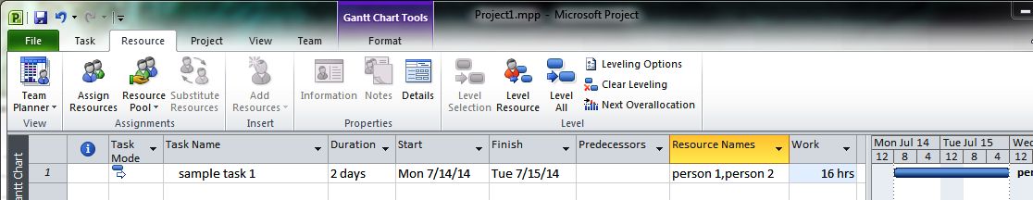
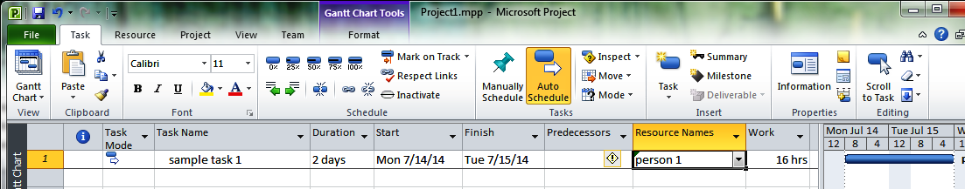
Fixed Duration Scheduling: Removing Resources, Case 1
Task is effort driven
Removing one person from the initial two-person task does the following:
keeps work and duration constant; doubles hours/day for last resource
raises an information box, which affords three options:
keep schedule shown above
keep work constant; double the duration to 4 days
keep duration constant; halve total work to 16 hours

Slide 42
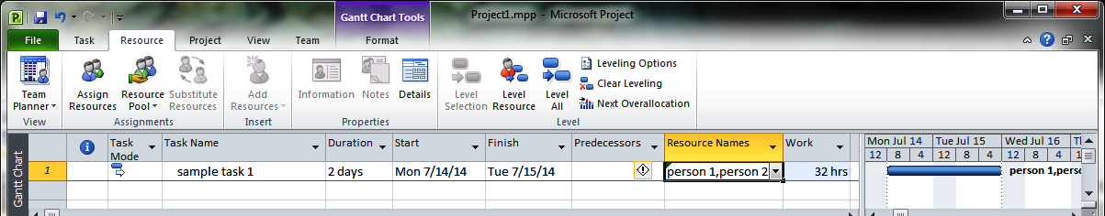
Fixed Duration Scheduling: Adding Resources, Case 2
Task is not effort driven
Adding a second person to the initial one-person task does the following:
increases work from 16 to 32 hours
raises an information box, which affords three options:
keep schedule shown above
keep work constant; reduce the duration to 1 day
keep work and duration constant; reduce each resource's work load to 50%

Slide 43
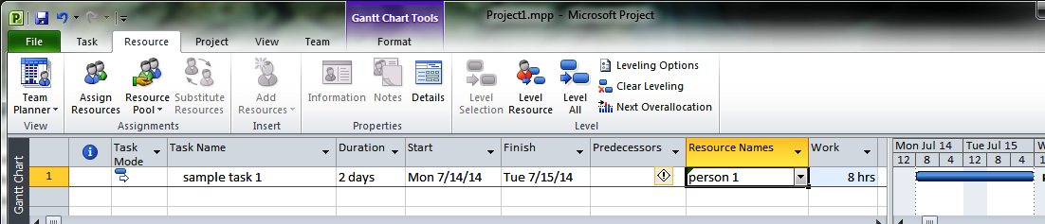
Fixed Duration Scheduling: Removing Resources, Case 2
Task is not effort driven
Removing one person from the initial two-person task does the following:
decreases work from 16 to 8 hours
raises an information box, which affords three options:
keep schedule shown above
keep work constant; increase the duration to 2 days
keep work and duration constant; increase the work load to 200%

Slide 44
Auto-Scheduling: Responses to Changes in Duration, Units, or Work, with Constant Num. of Resources
DEFAULT response to changing one of {duration, units, work} on remaining two dimensions
 |  | increase (↑) duration | decrease (↓) duration |  | increase (↑) units | decrease (↓) units |  | increase (↑) work | decrease (↓) work
fixed duration |  | work ↑ units ↔ | work ↓ units ↔ |  | duration ↔ work ↑ | duration ↔ work ↓ |  | duration ↔ units ↑ | duration ↔ units ↓
fixed units |  | work ↑ units ↔ | work ↓ units ↔ |  | duration ↓ work ↔ | duration ↑ work ↔ |  | duration ↑ units ↔ | duration ↓ units ↔
fixed work |  | work ↔ units ↓ | work ↔ units ↑ |  | duration ↓ work ↔ | duration ↑ work ↔ |  | duration ↑ units ↔ | duration ↓ units ↔
notes |  | duration ∝ work duration ∝ 1 / units |  |  | units ∝ work units ∝ 1 / duration |  |  | work ∝ units work ∝ duration
Alternative ( ) responses to updating {duration, units, work} on change of one dimension
 |  | alter duration |  | alter units |  | alter work
fixed duration |  | alter units, leaving work unchanged |  | alter duration, leaving work unchanged |  | alter duration, leaving units unchanged
fixed units |  | alter units, leaving work unchanged |  | alter duration, leaving work unchanged |  | alter units , leaving duration unchanged
fixed work |  | alter work , leaving units unchanged |  | alter work, leaving duration unchanged |  | alter units, leaving duration unchanged

Slide 45
Responses to Changes in Number of Resources
Effort-driven |  | DEFAULT response |  |  | Alternative response #1 |  |  | Alternative response #2
 |  | increase (↑) resources | decrease (↓) resources |  | increase (↑) resources | decrease (↓) resources |  | increase (↑) resources | decrease (↓) resources
fixed duration |  | duration ↔ work ↔ hours/day ↓ | duration ↔ work ↔ hours/day ↑ |  | duration ↔ work ↑ | duration ↔ work ↓ |  | duration ↓ work ↔ | duration ↑ work ↔
fixed units |  | duration ↓ work ↔ | duration ↑ work ↔ |  | duration ↔ work ↑ | duration ↔ work ↓ |  | duration ↔ work ↔ hours/day ↓ | duration ↔ work ↔ hours/day ↑
fixed work |  | duration ↓ work ↔ | duration ↑ work ↔ |  | duration ↔ work ↑ | duration ↔ work ↓ |  | duration ↔ work ↔ hours/day ↓ | duration ↔ work ↔ hours/day ↑
Non-effort-driven |  | DEFAULT response |  |  | Alternative response #1 |  |  | Alternative response #2
 |  | increase (↑) resources | decrease (↓) resources |  | increase (↑) resources | decrease (↓) resources |  | increase (↑) resources | decrease (↓) resources
fixed duration |  | duration ↔ work ↑ | duration ↔ work ↓ |  | duration ↓ work ↔ | duration ↑ work ↔ |  | duration ↔ work ↔ hours/day ↓ | duration ↔ work ↔ hours/day ↑
fixed units |  | duration ↔ work ↑ | duration ↔ work ↓ |  | duration ↓ work ↔ | duration ↑ work ↔ |  | duration ↔ work ↔ hours/day ↓ | duration ↔ work ↔ hours/day ↑
fixed work |  | Not applicable; effort-driven always enabled for fixed work scheduling

Slide 46
Auto Scheduling Made Simple
I've tried repeatedly to reduce the last two slides to a couple of simple precepts
I can't

Slide 47
Scheduling Modes: Recommendations
Avoid mixing auto and manually scheduled tasks
Mixing the two seems can interfere quite badly with automated leveling
I've never seen this recommended, either
Do initial work breakdowns using manual scheduling
Auto scheduling forces each task to have a duration at all times
Project assigns new auto-scheduled tasks a duration of 1 day?
This default can be an annoyance
Switch to auto scheduling when adding estimates
This allows for automated leveling with d/w/u tradeoffs
Auto scheduling, for all its quirks, is invaluable for revising schedules
Specifying units vs. duration vs. work
Specify fixed units when number of people on task is fixed
Specify fixed duration for tasks like meetings whose times are (more or less) independent of group size
Specify fixed work when amount of work to do is (more or less) constant
I tend to such tasks as effort-driven, as well
Do verify that Project did what you hoped it would when changing scheduling parameters for an auto-scheduled task

